Slide 1
AI & Analytics Capabilities Deck – Contact Center Community

Slide 2
Notes
Start Here: What Does the Client Want? (intent-based questions)
Pick Your Stack:
NVIDIA-Powered
Google CCAI
Amazon Connect + LEX + BEDROCK + OPENSEARCH(RAG)
Genesys Cloud CX + CCAI + VERTEX AI MATCHING ENGINE
Kore.ai Driven
AZURE + OPENAI + COGNITIVE SEARCH + ON PREM
Solution Blueprints:
Voice AI Agent
Auto Summarization
Agent Assist
Sentiment Analytics
Real-World Case Studies:
Platform Comparison + Build Strategy

Slide 3
WHY?
Today, high stakes contact centers, especially in financial services; customer expectations, compliance, and cost challenges are rising simultaneously.
Our platform will address all three using Generative AI and AI Agents to automate tasks, assist other agents, and deliver smarter decisions across every platform.

Slide 4
HOW?
We plan to solve these issues by delivering an enterprise grade AI-Powered contact center framework:
Automate repetitive voice/chat tasks using conversational AI
Enhance human agents with real-time assist tools and AI agents
Connect securely to your internal data, with full compliance
Unlock customer and agent insights using advanced analytics and tracking
Support AWS, GCP, Azure, hybrid, or on-prem setups; your stack, your choice!

Slide 5
WHAT?
HOW IT WORKS
Intent Recognition: Understanding what you customers are asking through advanced natural language processing.
Routing & Orchestration: Route to AI, AI Agent Assist, or live agent based on rules, risk, and urgency.
Data Access & RAG: Retrieve contextual data from secure internal systems or documents using RAG workflows.
Response Generation: Generate compliant, useful responses via Industry-tuned AI models.
Monitoring & Feedback: Track resolutions, sentiment, compliance; optimize accordingly using analytic loops and historical data.

Slide 6

AUTOMATION: HOW CAN WE REDUCE AGENT CALL TIME?
CUSTOMER EXPERIENCE: CAN WE IMPROVE NPS AND FIRST CONTACT RESOLUTION?
RISK & COMPLIANCE: CAN WE ENSURE PRIVACY, SECURITY, AND AVOID HALLUCINATIONS?
DATA & ANALYTICS: CAN WE TRACK CSAT SENTIMENT OR FRAUD/INTENT IN REAL TIME?
SCALABILITY & FLEXIBILITY: WILL THIS WORK WITH OUR CLOUD/ON PREM INFRA?
HUMAN AUGMENTATION: HOW TO MAKE AI MORE COMPLIANT AND FASTER?

Slide 7
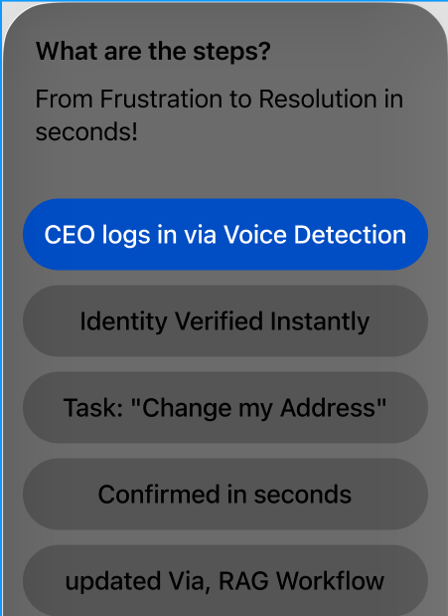
Use Case – Address Change
Imagine Your CEO just moved. He doesn’t have time to sit on a 10-minute call. Our solution understands intent, confirms identity, accesses the backend system, and updates all data; this being all within ONE conversational flow.

Slide 8
Real World:
Commonwealth Bank (CBA) - AI Handling
In Australia's largest bank, they deployed, and AI powered chat and voice agents to process ~50,000 inquiries daily.
They also used context-aware, grounded conversations to resolve routine issues instantly, this frees agents for other complex tasks.
NatWest & Openai
The Uk NatWest partnered with open ai to enhance their "Cora" chatbot and internal support assistant. The initiative was to improve digital fraud reporting capabilities.
This resulted in 150% increase customer satisfaction, and a decline in advisor hand offs.

Slide 9
Segment | Description | Key Tech Components | Example Tools/Platforms
1. Channel & Interaction Layer | Entry points and modes of communication | Voice, Chat, Email, SMS, Social, Video | Genesys, Amazon Connect, NICE, Five9, Twilio, WebRTC
2. Conversational Experience | Automated and hybrid experience across channels | IVR, Voice Bots, Chatbots, Smart IVAs | Kore.ai, Google CCAI, Nuance, IBM Watson, Intercom
3. Agent Enablement | Tools to assist live agents with intelligence and workflows | Agent Assist, Knowledge Surfacing, RPA | Salesforce Service Cloud, Genesys Agent Assist, NICE Enlighten
4. AI & Analytics Layer | Intelligence derived from interactions, context, and outcomes | NLU/NLP, Sentiment, Call Summarization, Intent Analytics | OpenAI, Azure AI, Amazon Bedrock, Google Vertex, Observe.AI
5. Workforce & Operations | Agent staffing, training, performance, QA | WEM, WFM, QM, Forecasting | Verint, NICE, Calabrio, Genesys WEM
6. Integration & Middleware | Connects CC tech to CRM, core banking, fraud engines | APIs, Middleware, Event Streams | MuleSoft, Kafka, Informatica, Boomi
7. CRM & Case Management | Client 360, service history, escalation | Omni-view CRMs and ticketing | Microsoft Dynamics, Salesforce FS Cloud, Pega
8. Compliance & Risk | Adherence to regulations, audit, fraud, privacy | Recording, Redaction, Alerts | NICE Compliance Center, Theta Lake, Verint
9. Data & Insights Hub | Aggregation, storage, and visualization of contact center data | Data Lakes, BI, Dashboards | Snowflake, Databricks, Tableau, Power BI
10. GenAI Orchestration & Governance | Prompt routing, safety, and stack abstraction | Prompt Gateways, Safety Filters, Usage Policies | Prompt Layer, AI Gateway, Tonic.ai, Weights & Biases

Slide 10
Real World Continued:
Morgan Stanley- Advisor tools Power by OpenAI
Morgan Stanley deployed AI in the Morgan Stanley assistant for financial advisors, this gives access to a searchable library of over 100 internal research documents.
Launched AI @ THE MS Debrief this automatically transcribed client meetings, highlighted the key points, then drafted follow up emails and logged them into a CRM. This saved Morgan Stanley 30 minutes per advisor.
Finally, then built a robost AI evals framework to ensure qaulity, compliance, and explainability, this is critical for government components such as banks.

Slide 11
Tech Stacks examples:
AWS:
Connect: For voice chat and routing.
Lex or Comprehend: For intent recognition.
Bedrock + OpenSearch: For secure explainable LLM with private data.
Lambda + S3 + Kendra + Gaurdrails: For full orchestration and safety.

Slide 12
Tech Stacks examples:
GCP:
Dialog CX: For conversational flows.
Vertex AI / Matching Engine: This is for a grounded ai and adding in vector search.
CCAI Insights: Real-time dashboards and transcripts.

Slide 13
Tech Stacks examples:
Azure / Hybrid / On-Prem:
Azure OpenAI: Using GPT-4 in the tenant and for modeling.
Vertex AI / Matching Engine: This is for a grounded ai and adding in vector search.
CCAI Insights: Real-time dashboards and transcripts.

Slide 14
Core Features: Delivering the Full Stack for Contact Centers
Voice AI Agent
Automate routine tasks using real time, speech aware bots
Agent Assist
Give live agent prompts, data fetches, and next-best-action support
Sentiment Analytics
Understand tone, frustration, urgency the route accordingly
RAG Workflows
Retrieve documents and client info to ground LLM responses
Auto Summarization
Genrate call notes, follow ups, and CRM logs instantly
Compliance Guardrails
Ensure responses are filtered and auditable

Slide 15
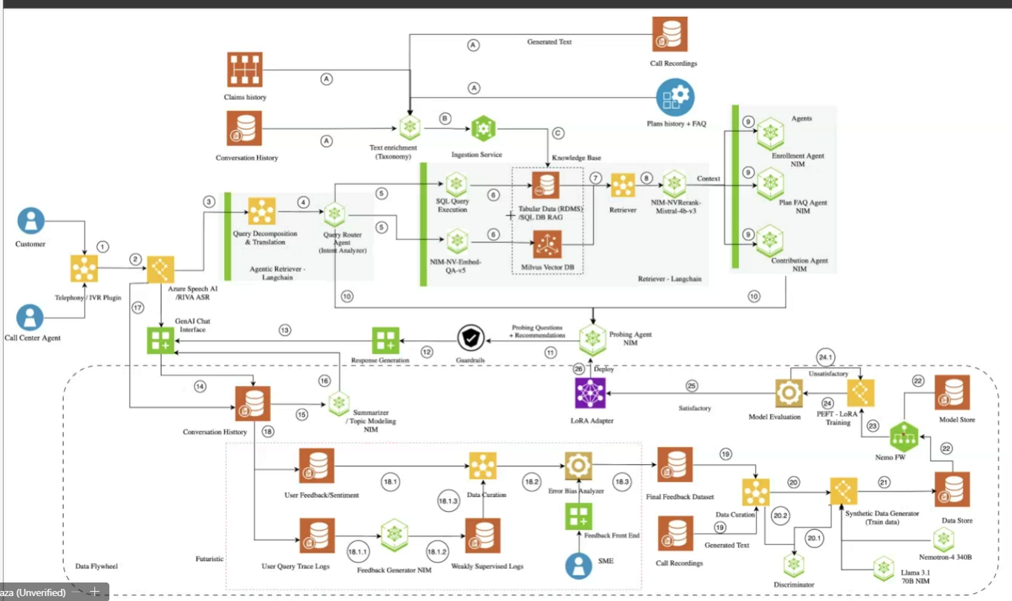

Slide 16












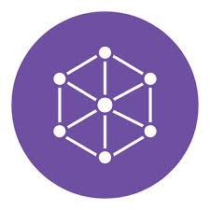



A
A
B
A
A
C
7
8
9
5
6
3
4
5
1
2
6
10
17
13
12
11
26
24.1
14
16
25
22
15
18.2
24
23
22
18
18.3
19
18.1
20
21
18.1.1
18.1.3
20.1
19
20.2
18.1.2

Slide 17
FAQs Help Knowledge bases
New
Google AI Trainer
New
Google Agent Assist
Google AI Coach
WFM
Hybrid Mode
New
Internet
Interaction Routing
Google Conversational Agent
Agent Workspace
Agent
Emotion/Sentiment/summary
New
Google Quality AI
Google Speech
Google Vertex AI
Google Agent Assist
Conversations
Google Conversational Insights
New
Customer Data Warehouses
/Platforms
Enterprise Systems
Google Action Connections
Disposition &ACW automations

Slide 18
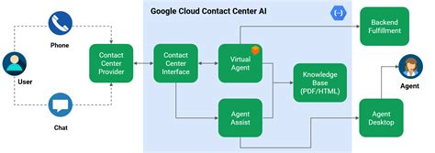

Slide 19
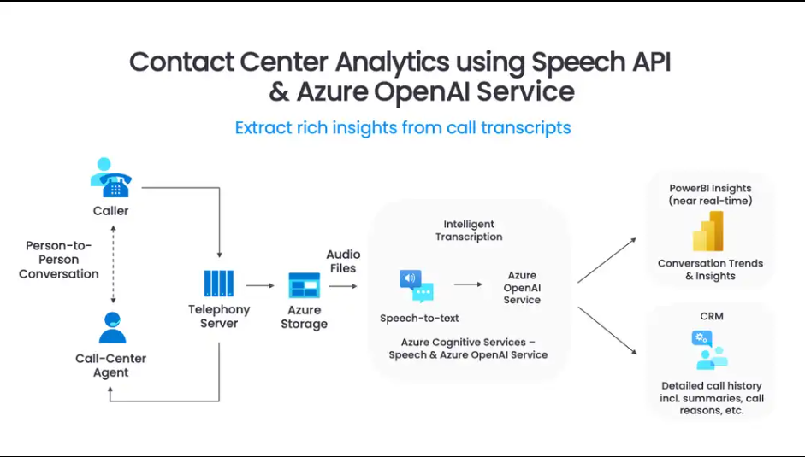

Slide 20
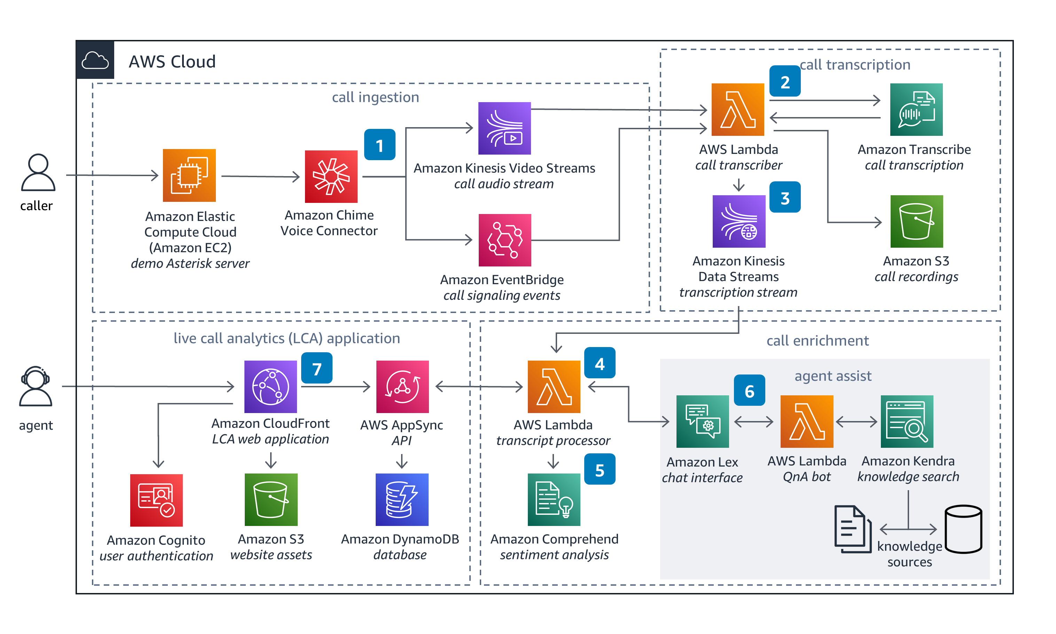

Slide 21
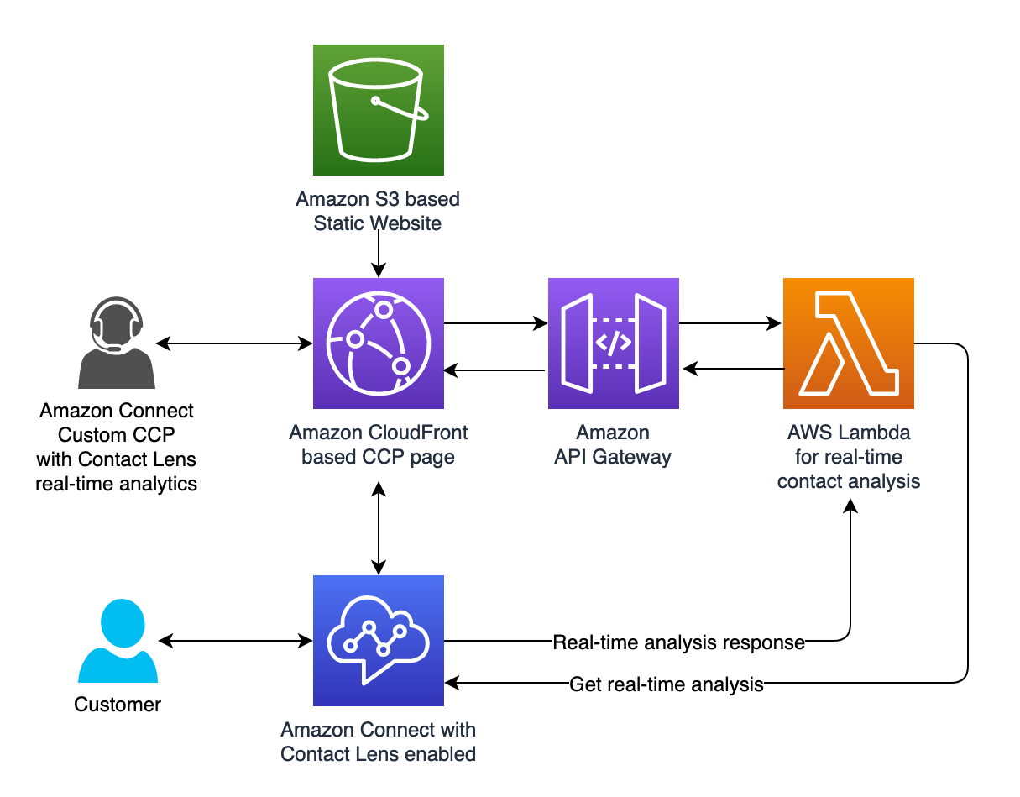

Slide 22
Our Edge
True Enterprise Grade – Platform agnostic solutions:
Our solution will work across AWS, Google Cloud, Azure, and even on prem or hybrid Infrastructures. With this, we give the optimization of your infrastructure and full control over governance, security, and existing data.

